Slide 1

The Consumers’ Role in the Energy Transition
Guest Prof. Hugo Morais / Host Prof. Bruno Dias

Slide 2
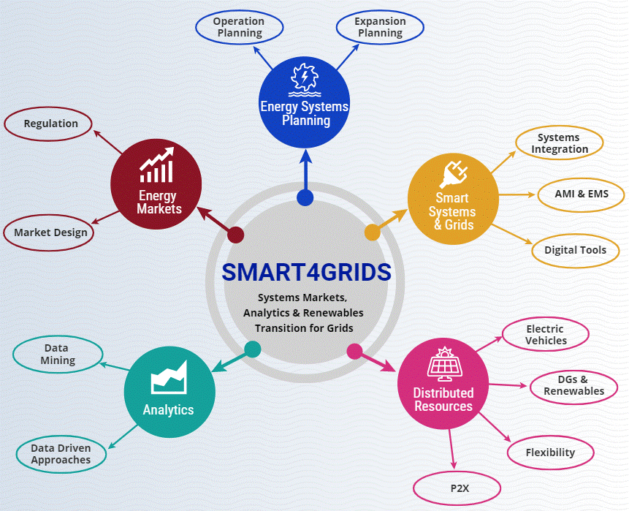
Research Group - Smart4Grids

Slide 3

Research Group - Smart4Grids
sites.google.com/engenharia.ufjf.br/smart4grids/
Diretório de Grupos de Pesquisa - CNPq
http://dgp.cnpq.br/dgp/espelhogrupo/701773

Slide 4
Course Agenda
8

